Slide 1
Workbook Potential Buyer Analysis
Internal Use Only
April 2017

Slide 2
Disclaimer
The content of this workbook has been produced by KPMG Germany/Deal Advisory on the basis of German accounting standards and/or IFRS, as well as considering KPMG Germany’s firm and country requirements, regulations, processes, policies and best practices. Please check your local accounting and other requirements before applying the content.

Slide 3
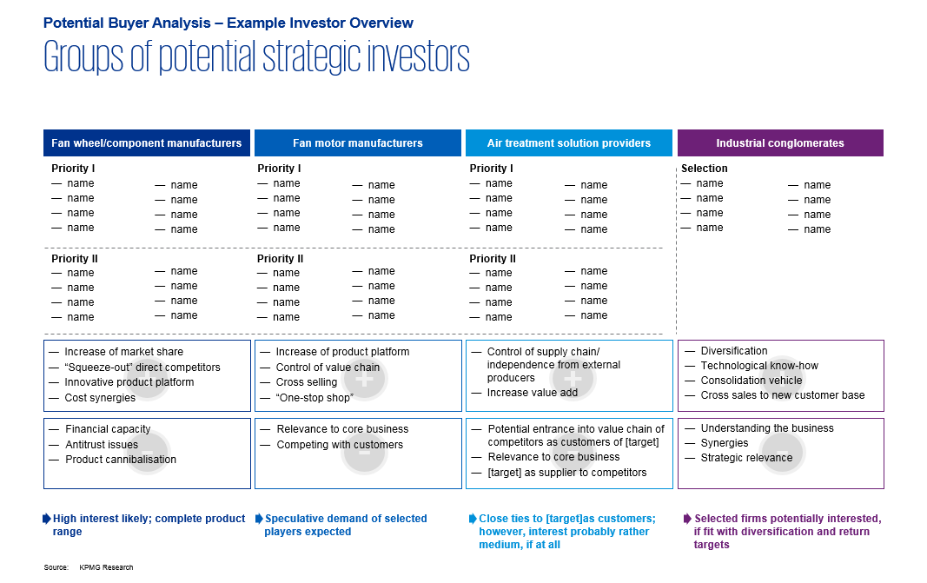
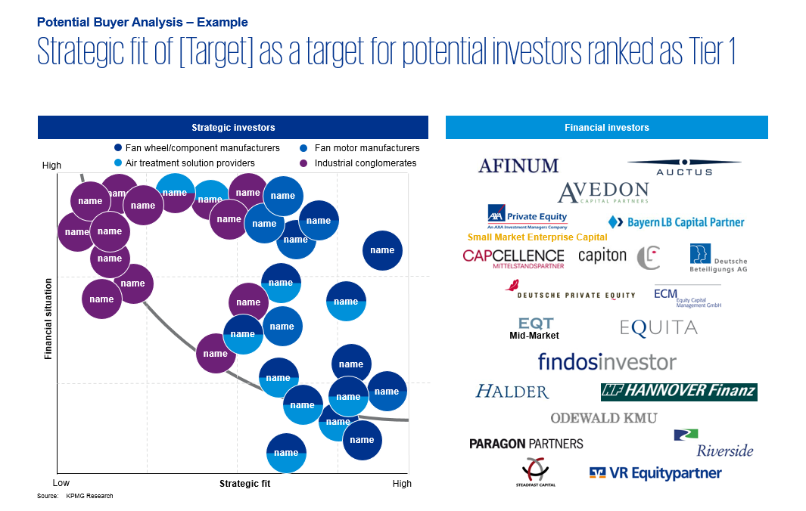
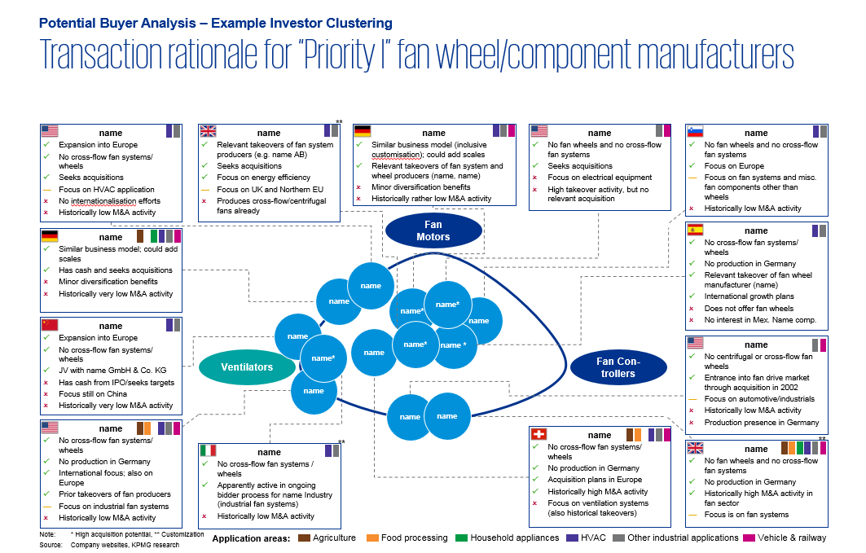
Overview (1/3) – Mission statement
Potential Buyer Analysis
Flag: Thomson Research, Capital IQ and MergerMarket tools are accessible in Germany. Please ask for available research tools in your region.
Mission Statement:
Presentation of potential buyers and estimation of strategic fits with the potential targets and financial strength of potential buyers
Customer situation
Definition/Methodology/Tools of the basis analysis
Sell Side/JV/Turnaround
Considerations of potential buyers in a sales process (alternative joint venture)
These consideration follow either in a pitch situation or in the framework of a kick-off meeting. In the latter it is decided which parties are short-listed (= who will be addressed in the framework of a sales process)
Methodology
Desktop research on potential buyers through industry associations, broker reports, Thomson Research, etc.
Interviews with industry contacts (e.g. from projects)
Take up contact to KPMG network (ideally this would already have occurred in a similar project)
Discussions with management/shareholders (if possible)
Tools
Thomson Research: Broker reports of listed companies screened for competitors
Capital IQ: Peer group search function + industry codes
MergerMarket: Transactions in similar areas
Thomson SDC: Access through research department
Degree of standardization
Uniform systematic with the presentation of the potential buyer
Standard templates with the presentation according to regions, fit, buyer groups, etc.

Slide 4
Overview (2/3) – Pitfalls
Potential Buyer Analysis
No. | Pitfalls/Lessons learned
 | In the analysis of the added value attention should be given to what extent an extension of the potential buyer’s value chain makes sense. Seldom do customers of the product of the target company integrate backwards, because then after the transaction the company would supply its competitors
 | The potential buyers presented should be investigated for solvency. Frequently the seller is very familiar with the companies that are listed as buyers. In the worst case a possible interested party is presented and you are immediately informed that it is almost insolvent
 | Geographic focus of the potential buyer should be aligned with the presence of the companies, e.g., for production goods that are difficult to transport, it is generally wise to only present companies that are active at least in geographically bordering areas
 | Estimate as of what magnitude an interested party has sufficient financial capacity, it is basically difficult to take over the target company. Even companies that are smaller than the target company may be in the position (e.g. through wealthy shareholders or private equity background). With very large companies it is important to identify the relevant field that would most likely drive a transaction
1
2
3
4

Slide 5
Overview (3/3) – Core issues
Potential Buyer Analysis
Core Issue | Specific analysis | Page(s)
What buyer groups are there? | Analysis of the value chain and the bordering areas on the sales side Analysis of potential buyer groups from the bordering industries and competition | 6-7
2. What is the strategic relevance for the potential buyers? | What is the relevant area for which the target company could be interesting? What strategy could the buyer be following with such a transaction? What statements from the management or the company are there in this regard? | 8, 10-11
What contact does KPMG have to potential buyers? | Especially in the framework of a pitch situation, a credible presentation of an active relationship to the potential buyers contributes KPMG as sell side advisor | 10-11
How many transactions has the potential buyer participated in in the past? | Checking the company news of MergerMarket and Thomson SDC (through the research department) Companies which have participated in M&A transactions in the past are typically more familiar with the process and trust in the possibility to grow through acquisitions | 10-11
Does the potential buyer have sufficient financial capacity? | Examination of the financial KPIs (especially profitability, cash position, debt) If there are no detailed financial KPIs available, an estimation is made based on market reports, sales or headcount | 10-11

Slide 6
Overview of ventilation products value chain and M&A activity in the sector
Potential Buyer Analysis – Example Value Chain Analysis
Component manufacturing/raw materials production
Fan component manufacturing
Assembly
Sales
Installation
Application
1
2
3
4
5
6
Components manufacturers
Fan controller manufacturers
Venti-lation
system manu-fact-urers
Sales
companies/ representation offices
Direct selling
Installers
End users
Fan drive manufacturers
Ventilation consultants
Component
manufacturers
Direct selling
Fan casting manufacturers
Distri-butors
Sales agents
Ventilation consultants
Input goods producers
(paint, steel, etc.)
Fan inlet manufacturers
Direct selling
Fan wheel manufacturers
Ventilation consultants
Covered by [Target]
Example transactions within the ventilation value chain:
Acquirer: [Acquiring company]
Target: [Target company]
Date: 20XX Deal value: n/a (revenue: €62.4m) Products: Axial and centrifugal fans, etc.
3
Acquirer: [Acquiring company]
Target: [Target company]
Date: 20XX Deal value: n/a Products: Axial and centrifugal fans, etc.
4
Acquirer: [Acquiring company]
Target: [Target company] Date: 20XX Deal value: n/a (revenue: €13m) Products: Axial and centrifugal fan systems, centrifugal fan wheels incl. casting, etc.
3
2
Acquirer: [Acquiring company]
Target: [Target company]
Date: 20XX Deal value: €52m Products: Centrifugal, roof and process fan wheels, as well as systems,etc.
3
2
3
We expect the highest strategic interest from component manufacturers trying to fill the gap towards a complete system supplier
Source: Company websites; KPMG Research; mergermarket; Company XYZ IPO prospect

Slide 7
Groups of potential strategic investors
Potential Buyer Analysis – Example Investor Overview
Fan wheel/component manufacturers
Fan motor manufacturers
Air treatment solution providers
Industrial conglomerates
Priority I
name
name
name
name
name
name
name
name
Priority I
name
name
name
name
name
name
name
name
Priority I
name
name
name
name
name
name
name
name
Selection
name
name
name
name
name
name
name
name
Priority II
name
name
name
name
name
name
name
name
Priority II
name
name
name
name
name
name
name
name
Priority II
name
name
name
name
name
name
name
name
Increase of market share
“Squeeze-out” direct competitors
Innovative product platform
Cost synergies
Increase of product platform
Control of value chain
Cross selling
“One-stop shop”
Control of supply chain/ independence from external producers
Increase value add
Diversification
Technological know-how
Consolidation vehicle
Cross sales to new customer base
+
+
+
+
Financial capacity
Antitrust issues
Product cannibalization
Relevance to core business
Competing with customers
Potential entrance into value chain of competitors as customers of [target]
Relevance to core business
[target] as supplier to competitors
Understanding the business
Synergies
Strategic relevance
-
-
-
-
High interest likely; complete product range
Speculative demand of selected players expected
Close ties to [Target] as customers; however, interest probably rather medium, if at all
Selected firms potentially interested, if fit with diversification and return targets
Source: KPMG Research

Slide 8








Transaction rationale for “Priority I” fan wheel/component manufacturers
Potential Buyer Analysis – Example Investor Clustering
**
name
Expansion into Europe
No cross-flow fan systems/ wheels
Seeks acquisitions
Focus on HVAC application
No internationalization efforts
Historically low M&A activity
name
Relevant takeovers of fan system producers (e.g. name AB)
Seeks acquisitions
Focus on energy efficiency
Focus on UK and Northern EU
Produces cross-flow/centrifugal fans already
name
Similar business model (inclusive customization); could add scales
Relevant takeovers of fan system and wheel producers (name, name)
Minor diversification benefits
Historically rather low M&A activity
name
No fan wheels and no cross-flow fan systems
Seeks acquisitions
Focus on electrical equipment
High takeover activity, but no relevant acquisition
name
No fan wheels and no cross-flow fan systems
Focus on Europe
Focus on fan systems and misc. fan components other than wheels
Historically low M&A activity
Fan Motors
name
No cross-flow fan systems/ wheels
No production in Germany
Relevant takeover of fan wheel manufacturer (name)
International growth plans
Does not offer fan wheels
No interest in Mex. Name comp.
name
Similar business model; could add scales
Has cash and seeks acquisitions
Minor diversification benefits
Historically very low M&A activity
name
name
name*
name*
name
name
Expansion into Europe
No cross-flow fan systems/ wheels
JV with name GmbH & Co. KG
Has cash from IPO/seeks targets
Focus still on China
Historically very low M&A activity
name
name*
name *
name*
name
name
No centrifugal or cross-flow fan wheels
Entrance into fan drive market through acquisition in 2002
Focus on automotive/industrials
Historically low M&A activity
Production presence in Germany
Ventilators
Fan Con-trollers
name
name
name
name
No cross-flow fan systems/ wheels
No production in Germany
International focus; also on Europe
Prior takeovers of fan producers
Focus on industrial fan systems
Historically low M&A activity
name
No cross-flow fan systems/ wheels
No production in Germany
Acquisition plans in Europe
Historically high M&A activity
Focus on ventilation systems (also historical takeovers)
**
**
name
No cross-flow fan systems / wheels
Apparently active in ongoing bidder process for name Industry (industrial fan systems)
Historically low M&A activity
name
No fan wheels and no cross-flow fan systems
No production in Germany
Historically high M&A activity in fan sector
Focus is on fan systems
Note: * High acquisition potential, ** Customization
Source: Company websites, KPMG research
Application areas:
Agriculture
Food processing
Household appliances
HVAC
Other industrial applications
Vehicle & railway

Slide 9
















Strategic fit of [Target] as a target for potential investors ranked as Tier 1
Potential Buyer Analysis – Example
Strategic investors
Financial investors
Fan wheel/component manufacturers
Fan motor manufacturers
High
Air treatment solution providers
Industrial conglomerates
name
name
name
name
name
name
name
name
name
name
name
name
name
name
name
Small Market Enterprise Capital
name
name
name
name
name
Financial situation
name
name
Sample financial investors
name
Mid-Market
name
name
name
name
name
name
name
name
Low
Strategic fit
High
Source: KPMG Research

Slide 10

Demolition/decommissioning companies and conglomerates with demolition/decommissioning activities
Potential Buyer Analysis - Example Investor profiles
Name/Type/Country | Financials (€m) | Strategic Fit | Financial Capacity | M&A Activity | Operations and M&A | Comments
Name Plc. Public company United Kingdom Contact through: Max Mustermann | Revenue: x EBITDA: y Long-term debt: z Cash: q Market cap.: xyz (as of Sep. 20XX) |  |  |  | Relevant activity: Name Plc. offers asbestos removal, asbestos management, demolition, land remediation and specialist environmental support services. The company consists of two subsidiaries: B and C. Via its B it provides dismantling, decommissioning and demolition services in various sectors such as nuclear, chemical, petrochemical, energy, power, defense, manufacturing, pharmaceutical, heavy mineral extraction and processing. Via C it delivers asbestos and environmental consulting Geography: Offers its services worldwide M&A: The company was involved in 7 known acquisitions in 20XX, thereof 4 in the relevant sector: In 20XX, B acquired the UK-based Example Company Ltd., an industrial and nuclear decommissioning company In 20XX; acquisition of B Group Holdings Ltd. | “I would like to think the group is more attractive following the B deal. It was a transformational deal and has given us a visible earnings stream and strong platform for growth," he told this news service. However, he stressed there were no takeover talks going on.” Source: mergermarket, 20XX
Name Group Private company Belgium Contact through: Mona Musterfrau | Revenue: x EBITDA: y Long-term debt: z Cash: xyz (as of Dec. 20XX) |  |  |  | Relevant activity: Via its subsidiary X, name Group provides demolition, dismantling, targeted detonation and asbestos removal services for industrial plants, private and public buildings as well as soil and water sanitization and infrastructure construction services. Via its division Y, the group also operates recycling centers. Furthermore, the group is active in project development and waterway transport Geography: Offers its services mainly in Belgium M&A: The company was involved in 2 known acquisitions since 20XX, but none in relevant sector | “Company B encompasses a range of companies which have been fostered by xy growth, achieved both through internal growth and external acquisition.” Source: name Group company website „Increasing real international expansion – XY success is not just regional, but also international. After XY completed its first soil remediation and industrial demolition job in Northern France...” Source: Company website

Slide 11
Demolition/decommissioning companies and conglomerates with demolition/decommissioning activities
Potential Buyer Analysis - Example Investor profiles
Name/Type/Country | Financials (€m) | Strategic Fit | Financial Capacity | M&A Activity | Operations and M&A | Comments
Name SE Public company Austria Contact through: Max Mustermann | Revenue: x EBITDA: y Long-term debt: z Cash: q Market cap.: xyz (as of Sep. 20XX) |  |  |  | Relevant activity: The company describes itself as “one of Europe’s leading construction groups”. It offers its services under several brands, including Company C and name. Its services include building and infrastructure construction, civil engineering, property and facility services, etc. Specifically, Company C provides site decontamination as well as demolition and dismantling services for industrial plants via its subsidiary name Environmental Technology. Via its subsidiary Umwelttechnik, it also provides site remediation, contaminated soil and other services. Furthermore, the company offers asbestos removal and waste treatment services. Geography: Offers its services worldwide, but mainly focuses on Europe M&A: The company was involved in 10 M&A transactions since 20XX, mainly in the construction sector and one in the relevant sector: In 20XX, acquisition of name, an Austrian recycling company engaged in gathering of waste. The company is also active in demolition services | “We see us as a provider of the entire range of construction services. If everything from the planning to the construction to the operation of the building comes from a single source, this reduces redundancies and simplifies the process for our clients. With this in mind, we have continually extended our value chain in the past few years, for example in the field of intelligent transport systems and electronic toll solutions or in the services business.” Source: company website
Name Holdings Ltd. Private company United Kingdom Contact through: Mona Musterfrau | Revenue: x EBITDA: y Long-term debt: z Cash: xyz (as of Dec. 20XX) |  |  |  | Relevant activity: Name is active in environmental engineering, demolition, property development, renewable energy and leisure. The company describes itself as one of the “leading contractors in demolition”. Its services include construction of infrastructure as well as other services such as demolition of infrastructure, commercial and residential buildings. It also offers excavation, contaminated materials treatment, material recycling and haulage services Geography: Offers its services mainly in the UK M&A: The company was involved in 2 known acquisitions since 20XX, but none of them in relevant sector | Family-owned business Source: Amadeus

Slide 12
© 2017 KPMG International Cooperative (“KPMG International”). KPMG International provides no client services and is a Swiss entity with which the independent member firms of the KPMG network are affiliated.

